Slide 1





VBF and VBS Measurements in ATLAS
Zhen Wang
2024/July/10
PASCOS 2024

Slide 2
01.
Motivation
04.
Signal extraction
02.
Background
05.
Unfolding
03.
Observation
06.
Summary

Slide 3
Motivation

Slide 4
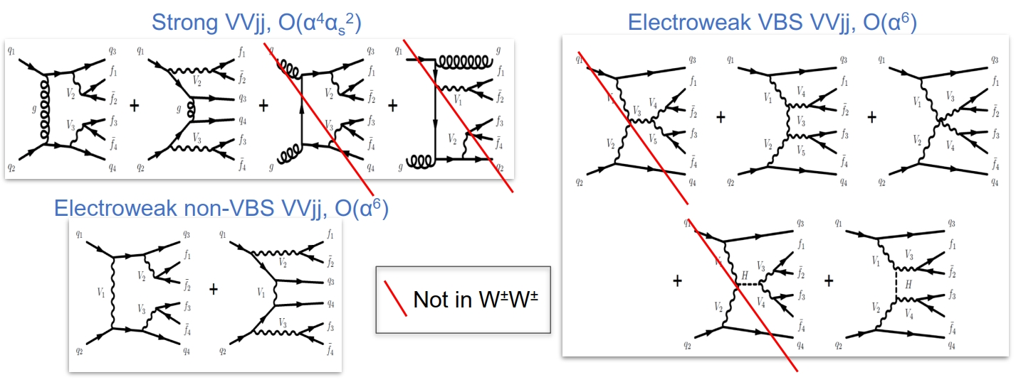

Same-sign $W^{±}W^{±}jj$
Motivation:
Massive vector boson scattering (VBS) probes mechanism of electroweak symmetry breaking (EWSB) in the Standard Model (SM)
Unique sensitivity for new physics phenomena
$W^{±}W^{±}jj$ final states has largest EW to QCD xsection ratio because of the suppression of QCD-induced background
EW measures both VBS and non-VBS process, inclusive measurements include EW + QCD + interference

Slide 5
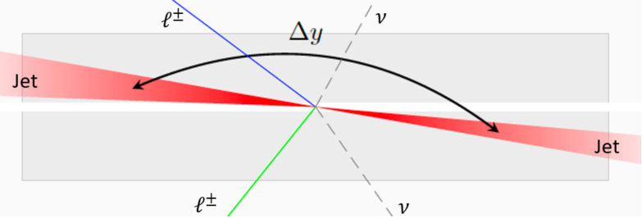
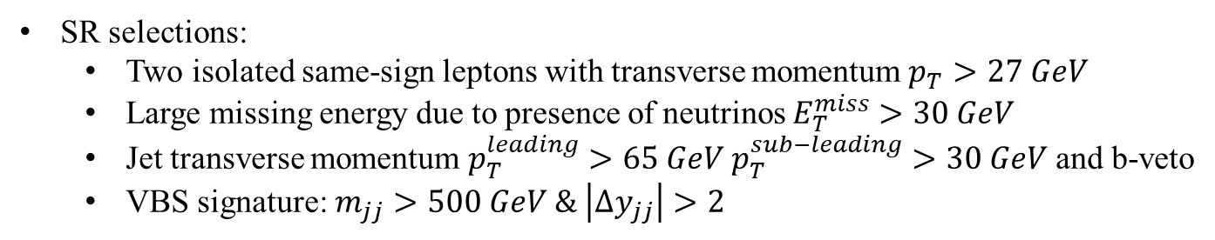
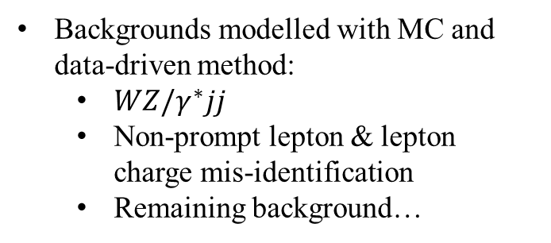

Same-sign $W^{±}W^{±}jj$ Strategy
SR selections:
Two isolated same-sign leptons with transverse momentum $p_{T}>27 GeV$
Large missing energy due to presence of neutrinos $E_{T}^{miss}>30 GeV$
Jet transverse momentum $p_{T}^{leading}>65 GeV p_{T}^{sub−leading}>30 GeV$ and b-veto
VBS signature: $m_{jj}>500 GeV \& \left|Δy_{jj}\right|>2$
WZ CR (improve modelling from QCD-induced $W^{±}Zjj$ events):
One more lepton with $p_{T}>15 GeV$
$m_{jj}>200 GeV$ & $m_{lll}>106 GeV$(suppress radiative Z decay)
Low-$m_{jj}$ CR (control uncertainties of major background in signal extraction fit):
$200 GeV<m_{jj}<500 GeV$
Backgrounds modelled with MC and data-driven method:
$WZ/γ^{∗}jj$
Non-prompt lepton & lepton charge mis-identification
Remaining background…

Slide 6
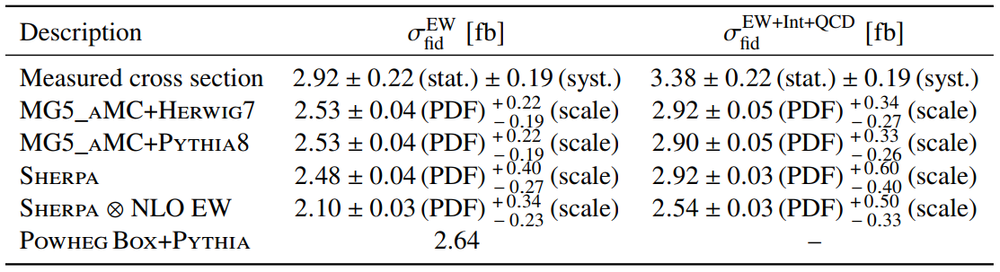
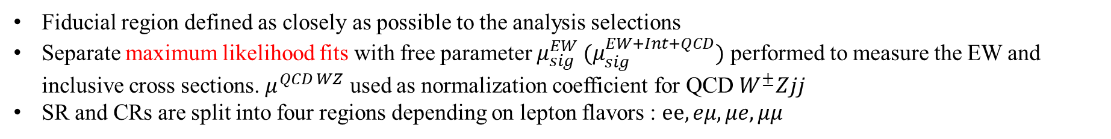
Same-sign $W^{±}W^{±}jj$ Fiducial Cross Section
Fiducial region defined as closely as possible to the analysis selections
Separate maximum likelihood fits with free parameter $μ_{sig}^{EW} (μ_{sig}^{EW+Int+QCD})$ performed to measure the EW and inclusive cross sections. $μ^{QCD WZ}$ used as normalization coefficient for QCD $W^{±}Zjj$
SR and CRs are split into four regions depending on lepton flavors : $ee,eμ,μe,μμ$
Predictions agree with the observed data within uncertainties generally
Observed cross section is slightly higher than predicted cross section

Slide 7
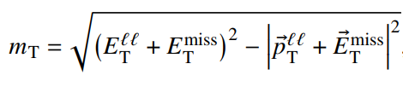
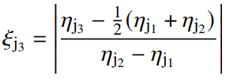
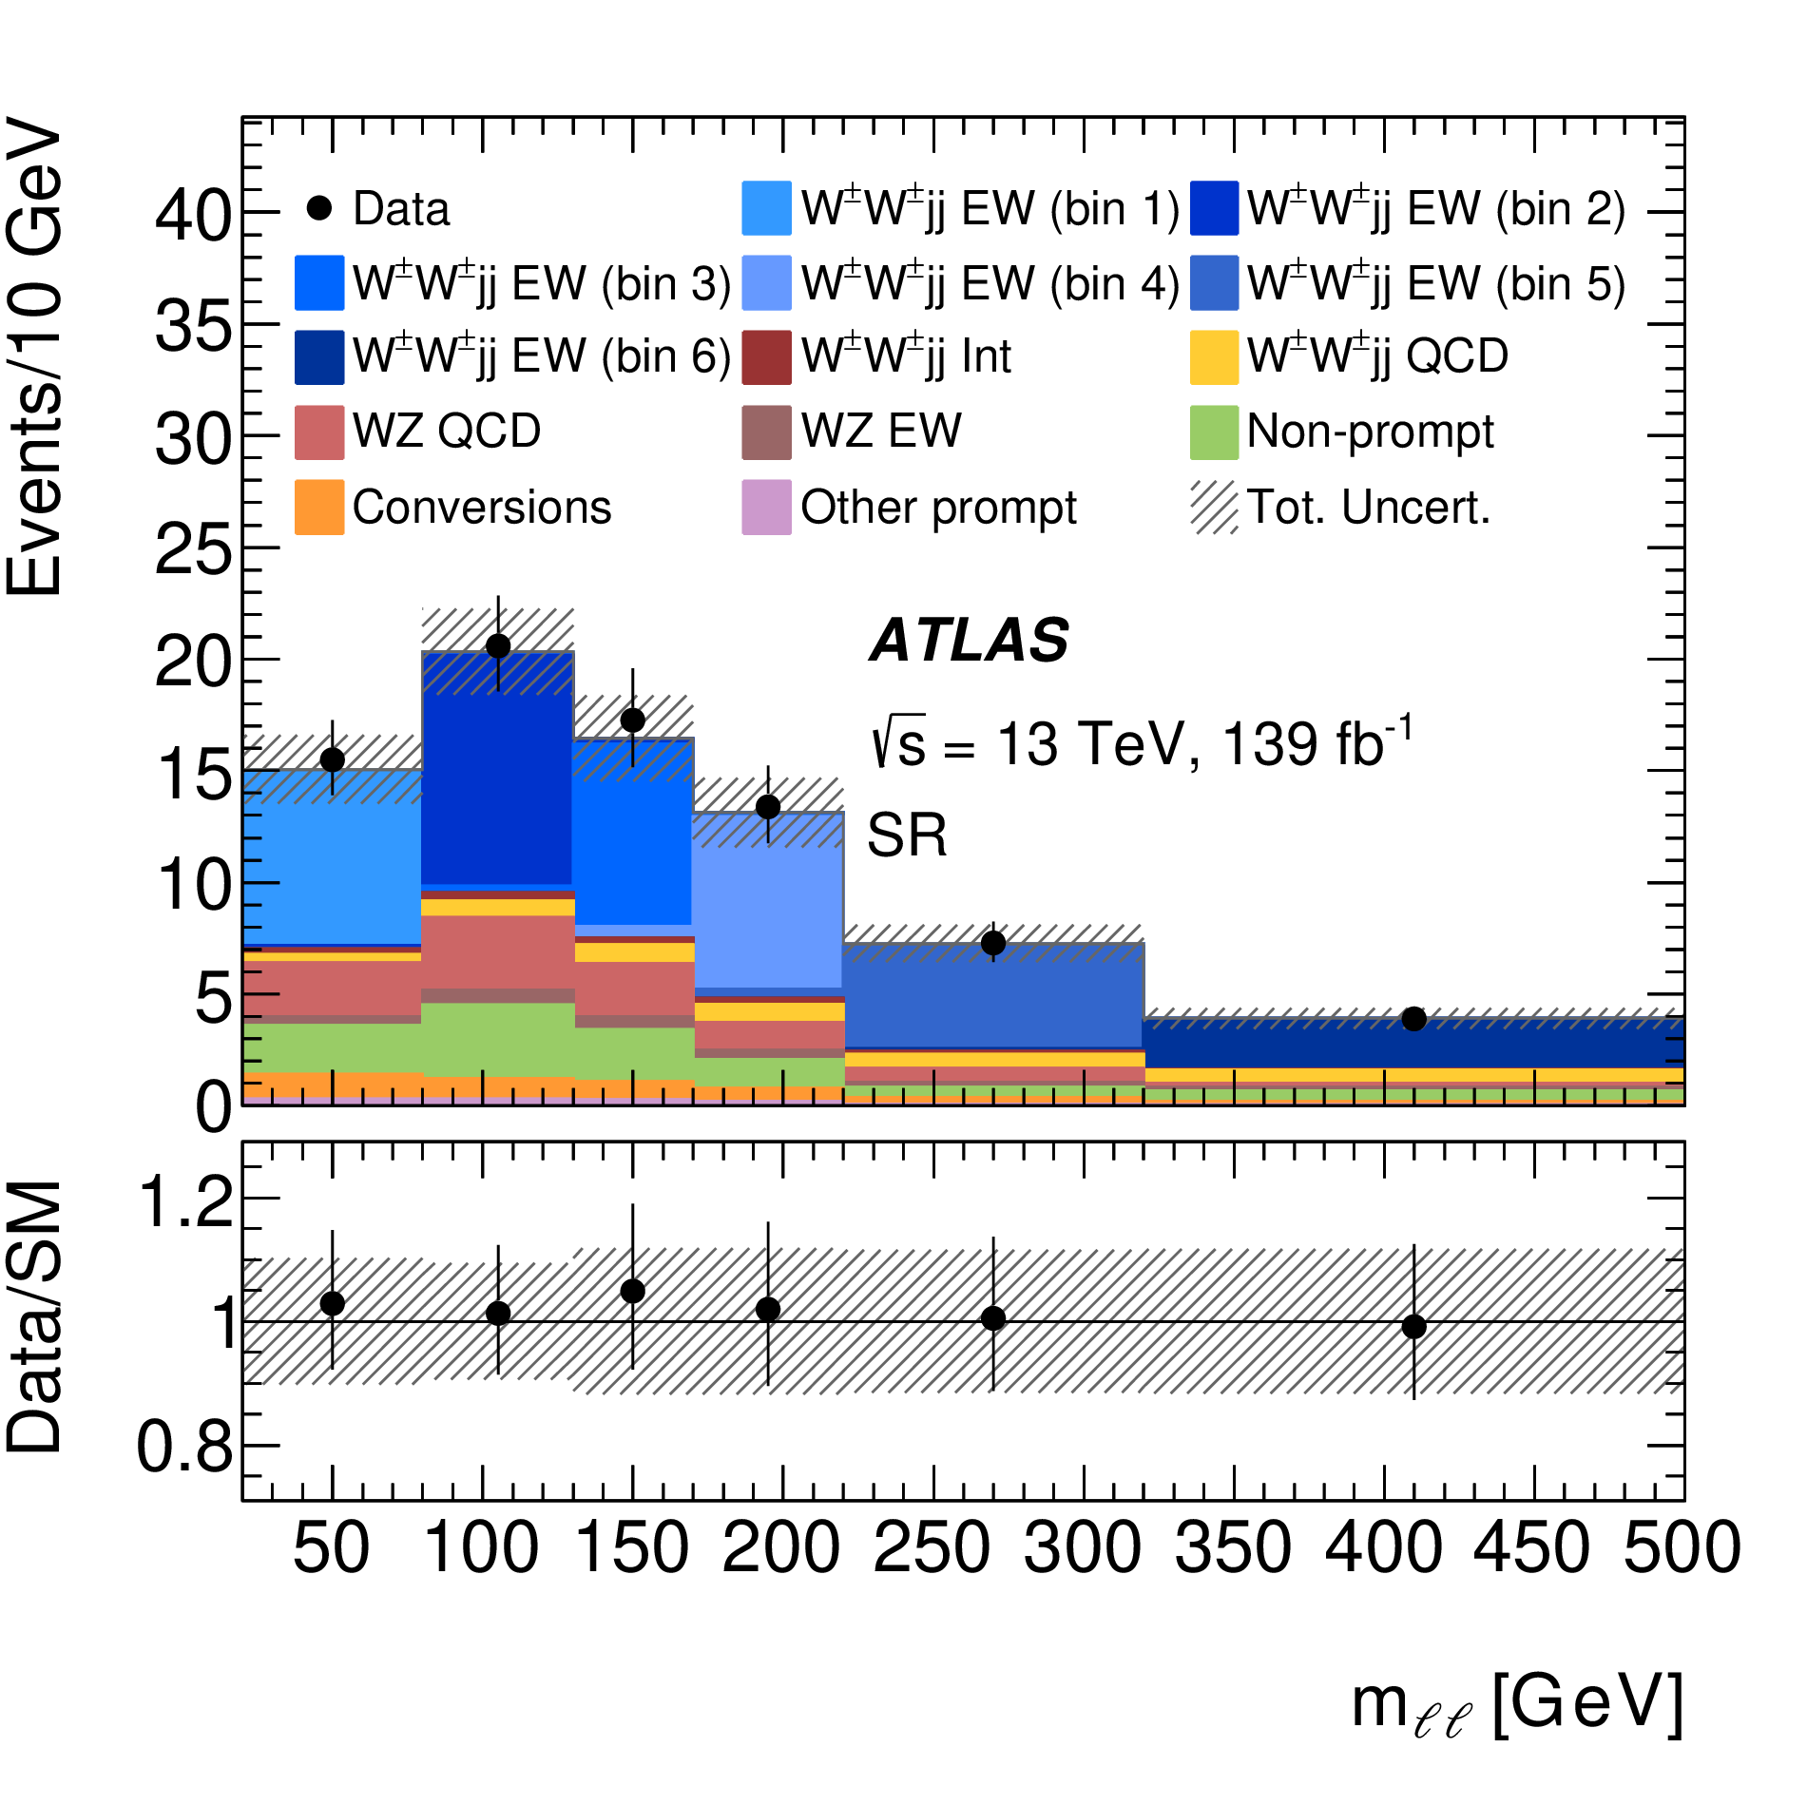
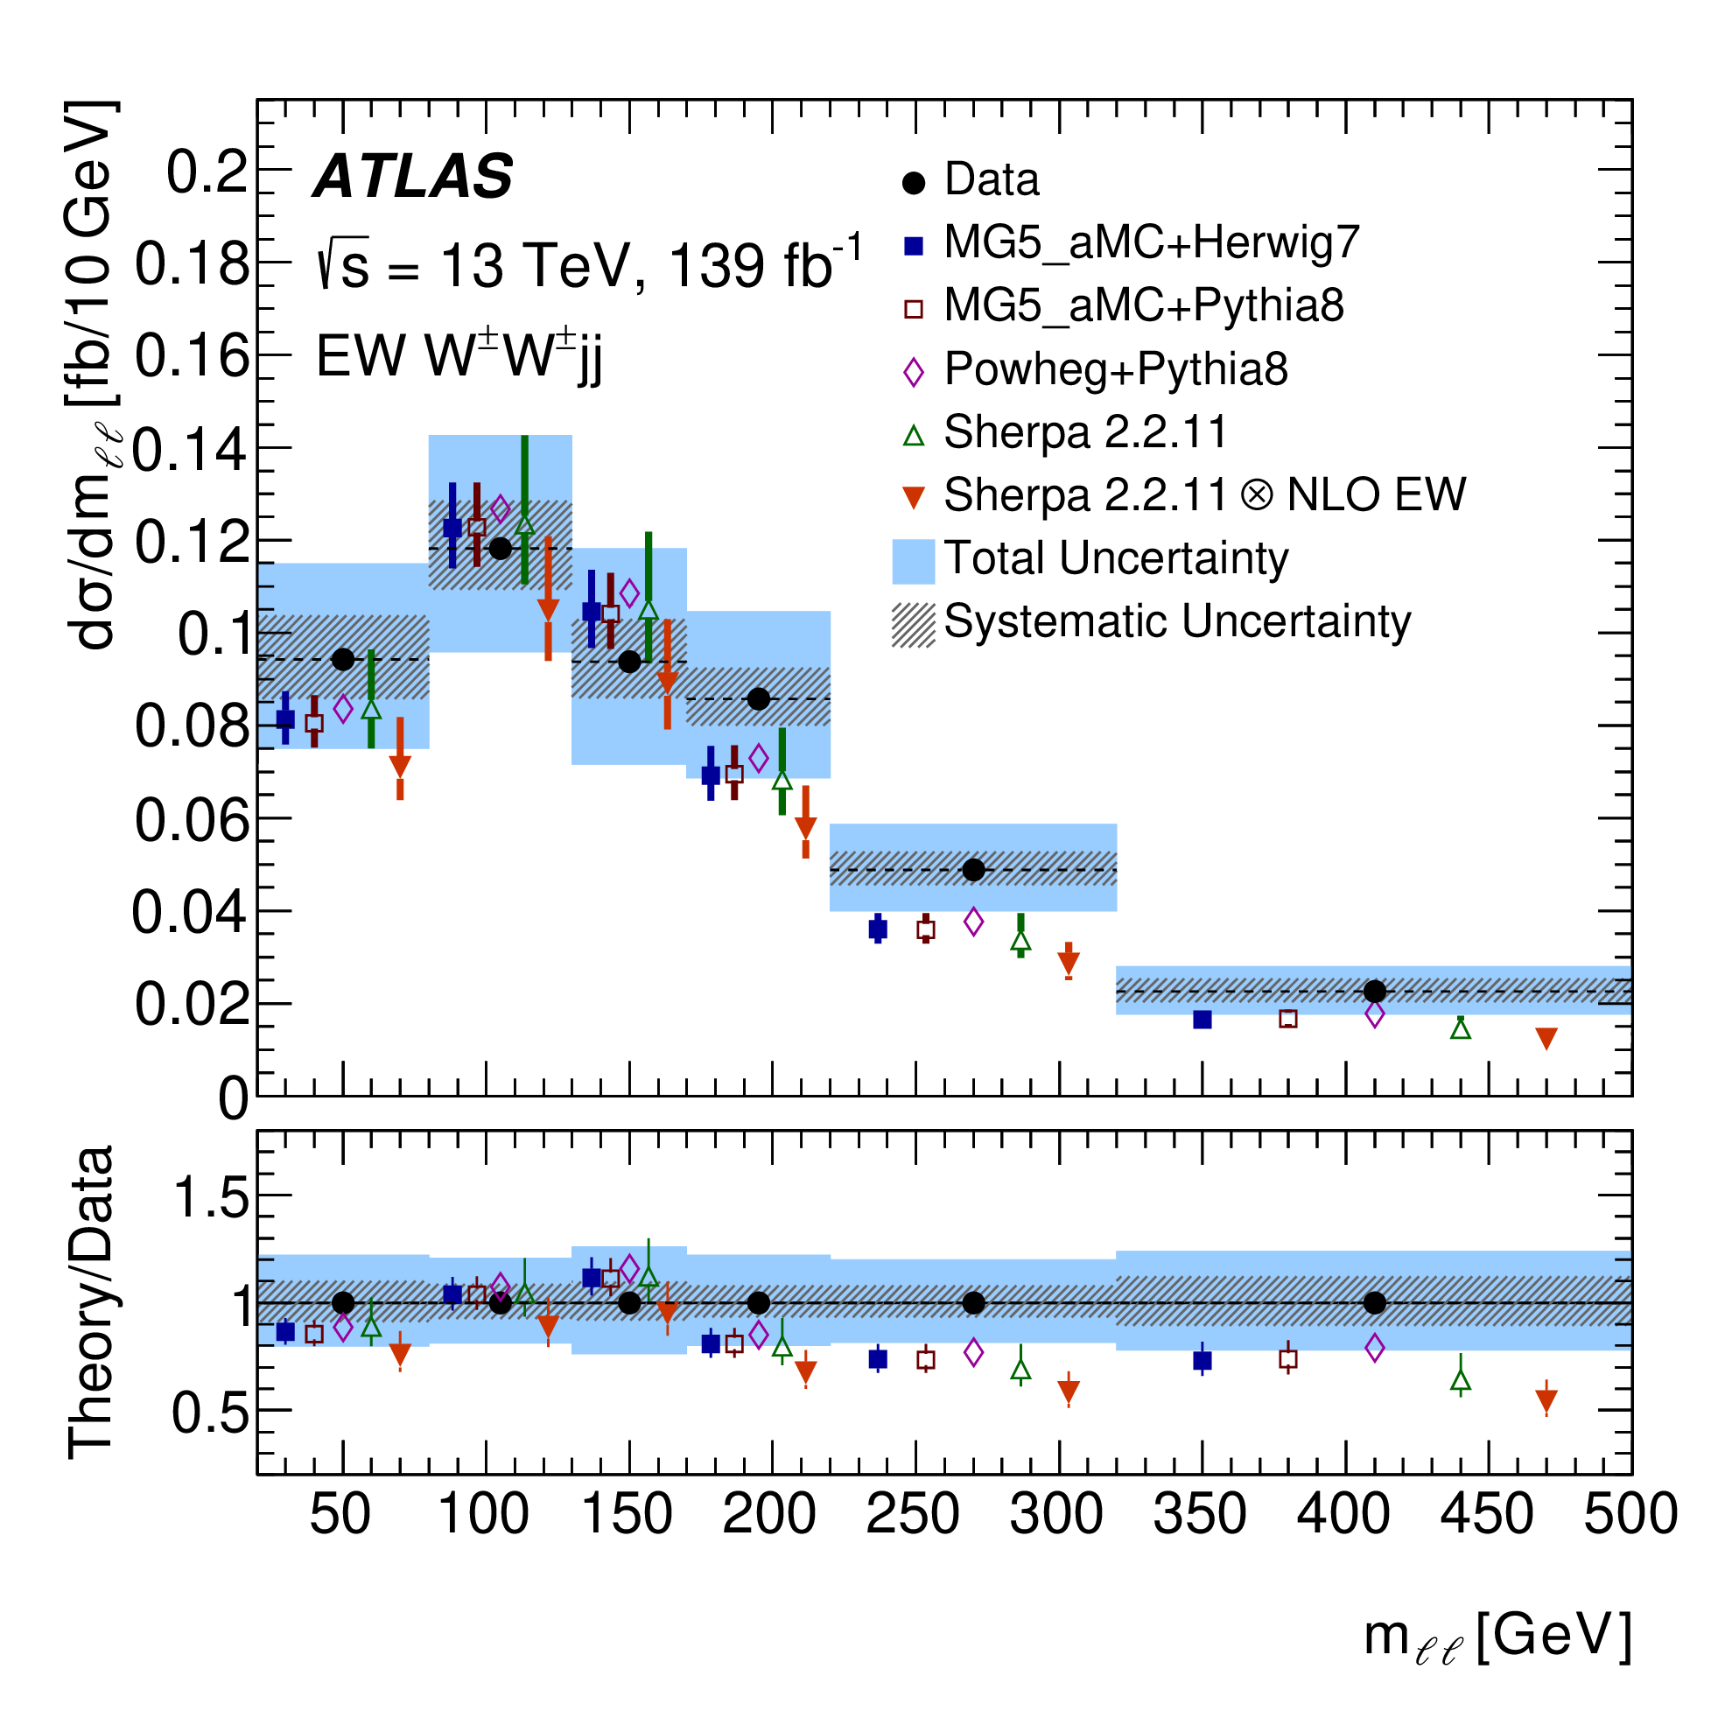
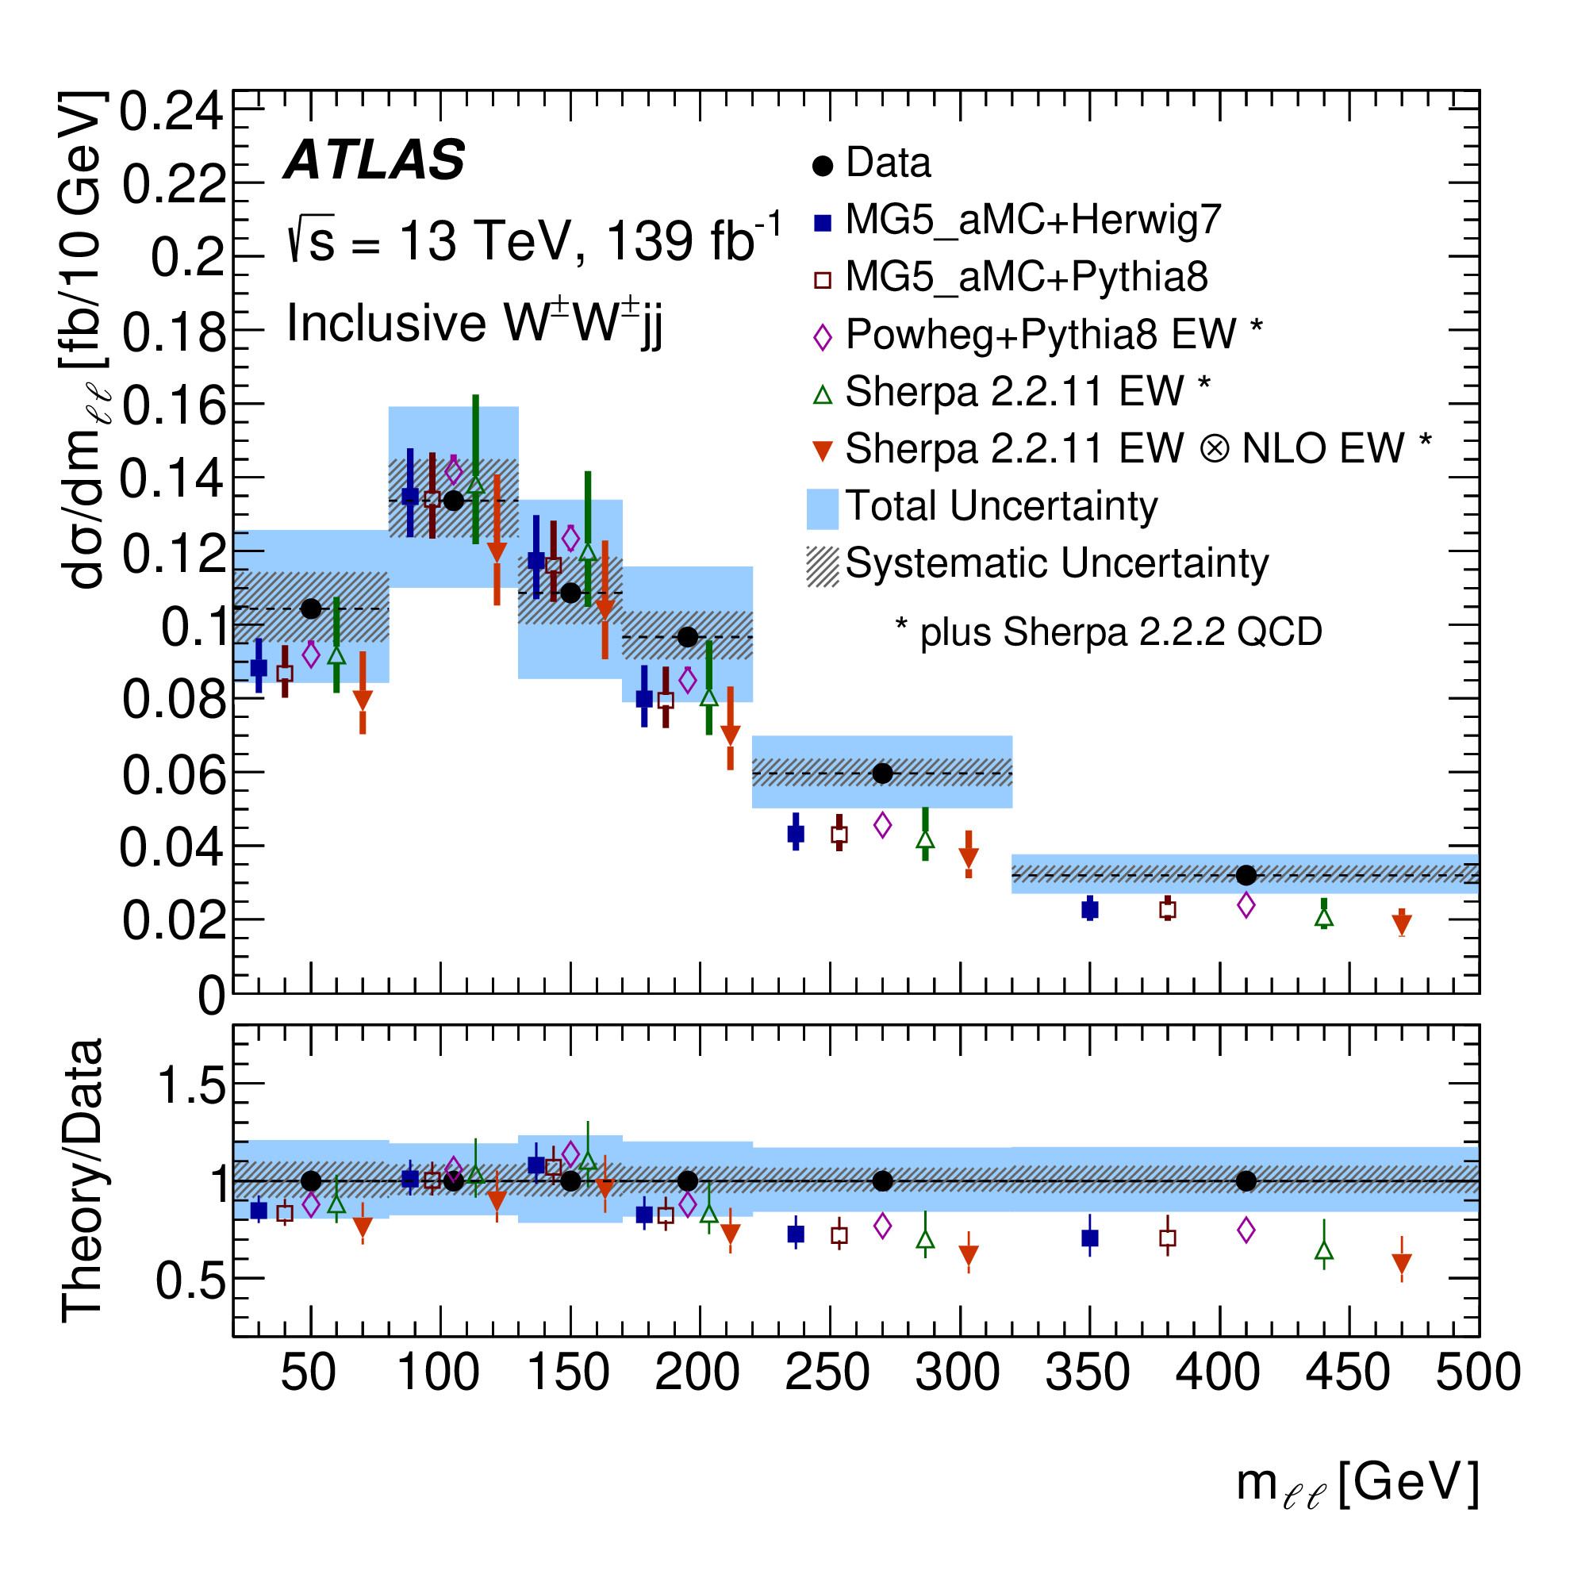
Same-sign $W^{±}W^{±}jj$ Differential Cross Section
Same fiducial space is used for extraction of differential cross section
A maximum-likelihood fit is performed to do the cross section unfolding
Five observables $m_{ll},m_{T},m_{jj},N_{gapjets} and ξ_{j3}$ are studied
Prediction underestimates data but is in good agreements within uncertainties

Slide 8
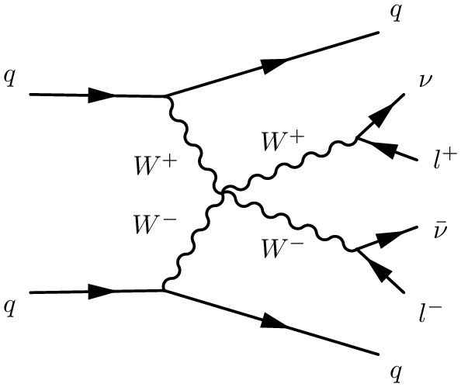
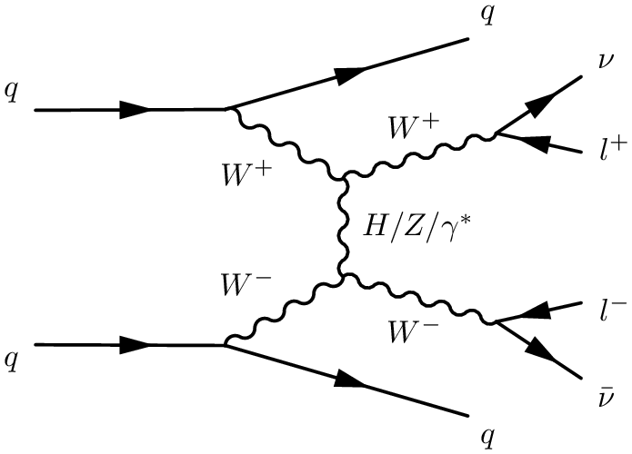
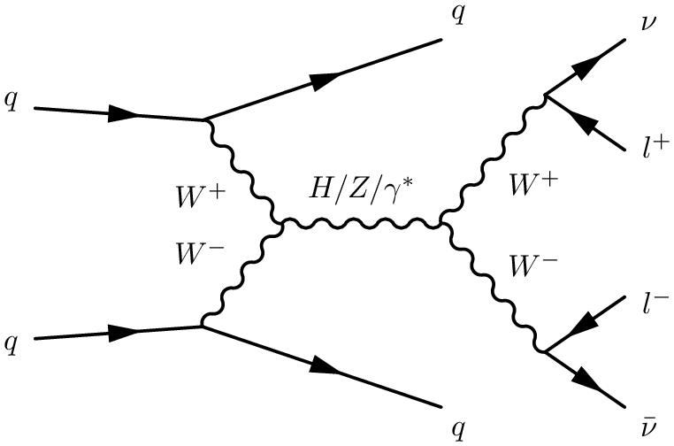
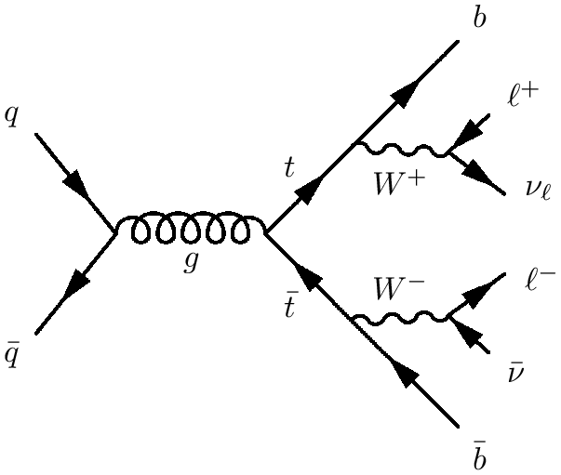
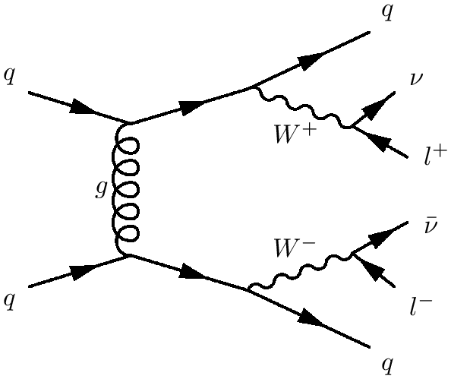
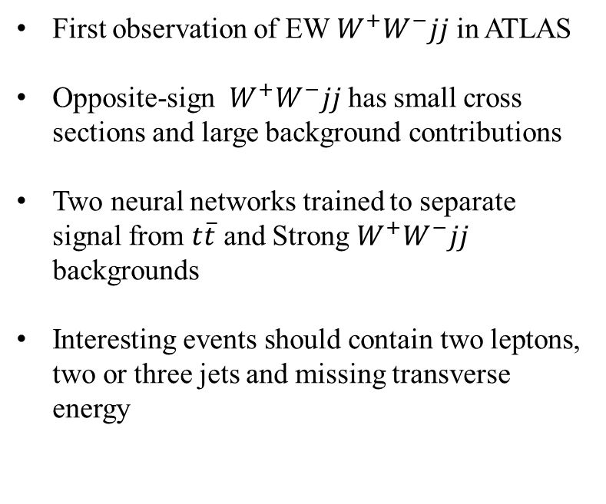

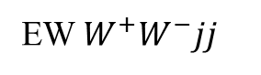
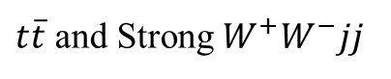
Opposite-sign $W^{+}W^{−}jj$
First observation of EW $W^{+}W^{−}jj$ in ATLAS
Opposite-sign $W^{+}W^{−}jj$ has small cross sections and large background contributions
Two neural networks trained to separate signal from $t\overline{t}$ and Strong $W^{+}W^{−}jj$ backgrounds
Interesting events should contain two leptons, two or three jets and missing transverse energy
EW $W^{+}W^{−}jj$
$t\overline{t}$ and Strong $W^{+}W^{−}jj$

Slide 9
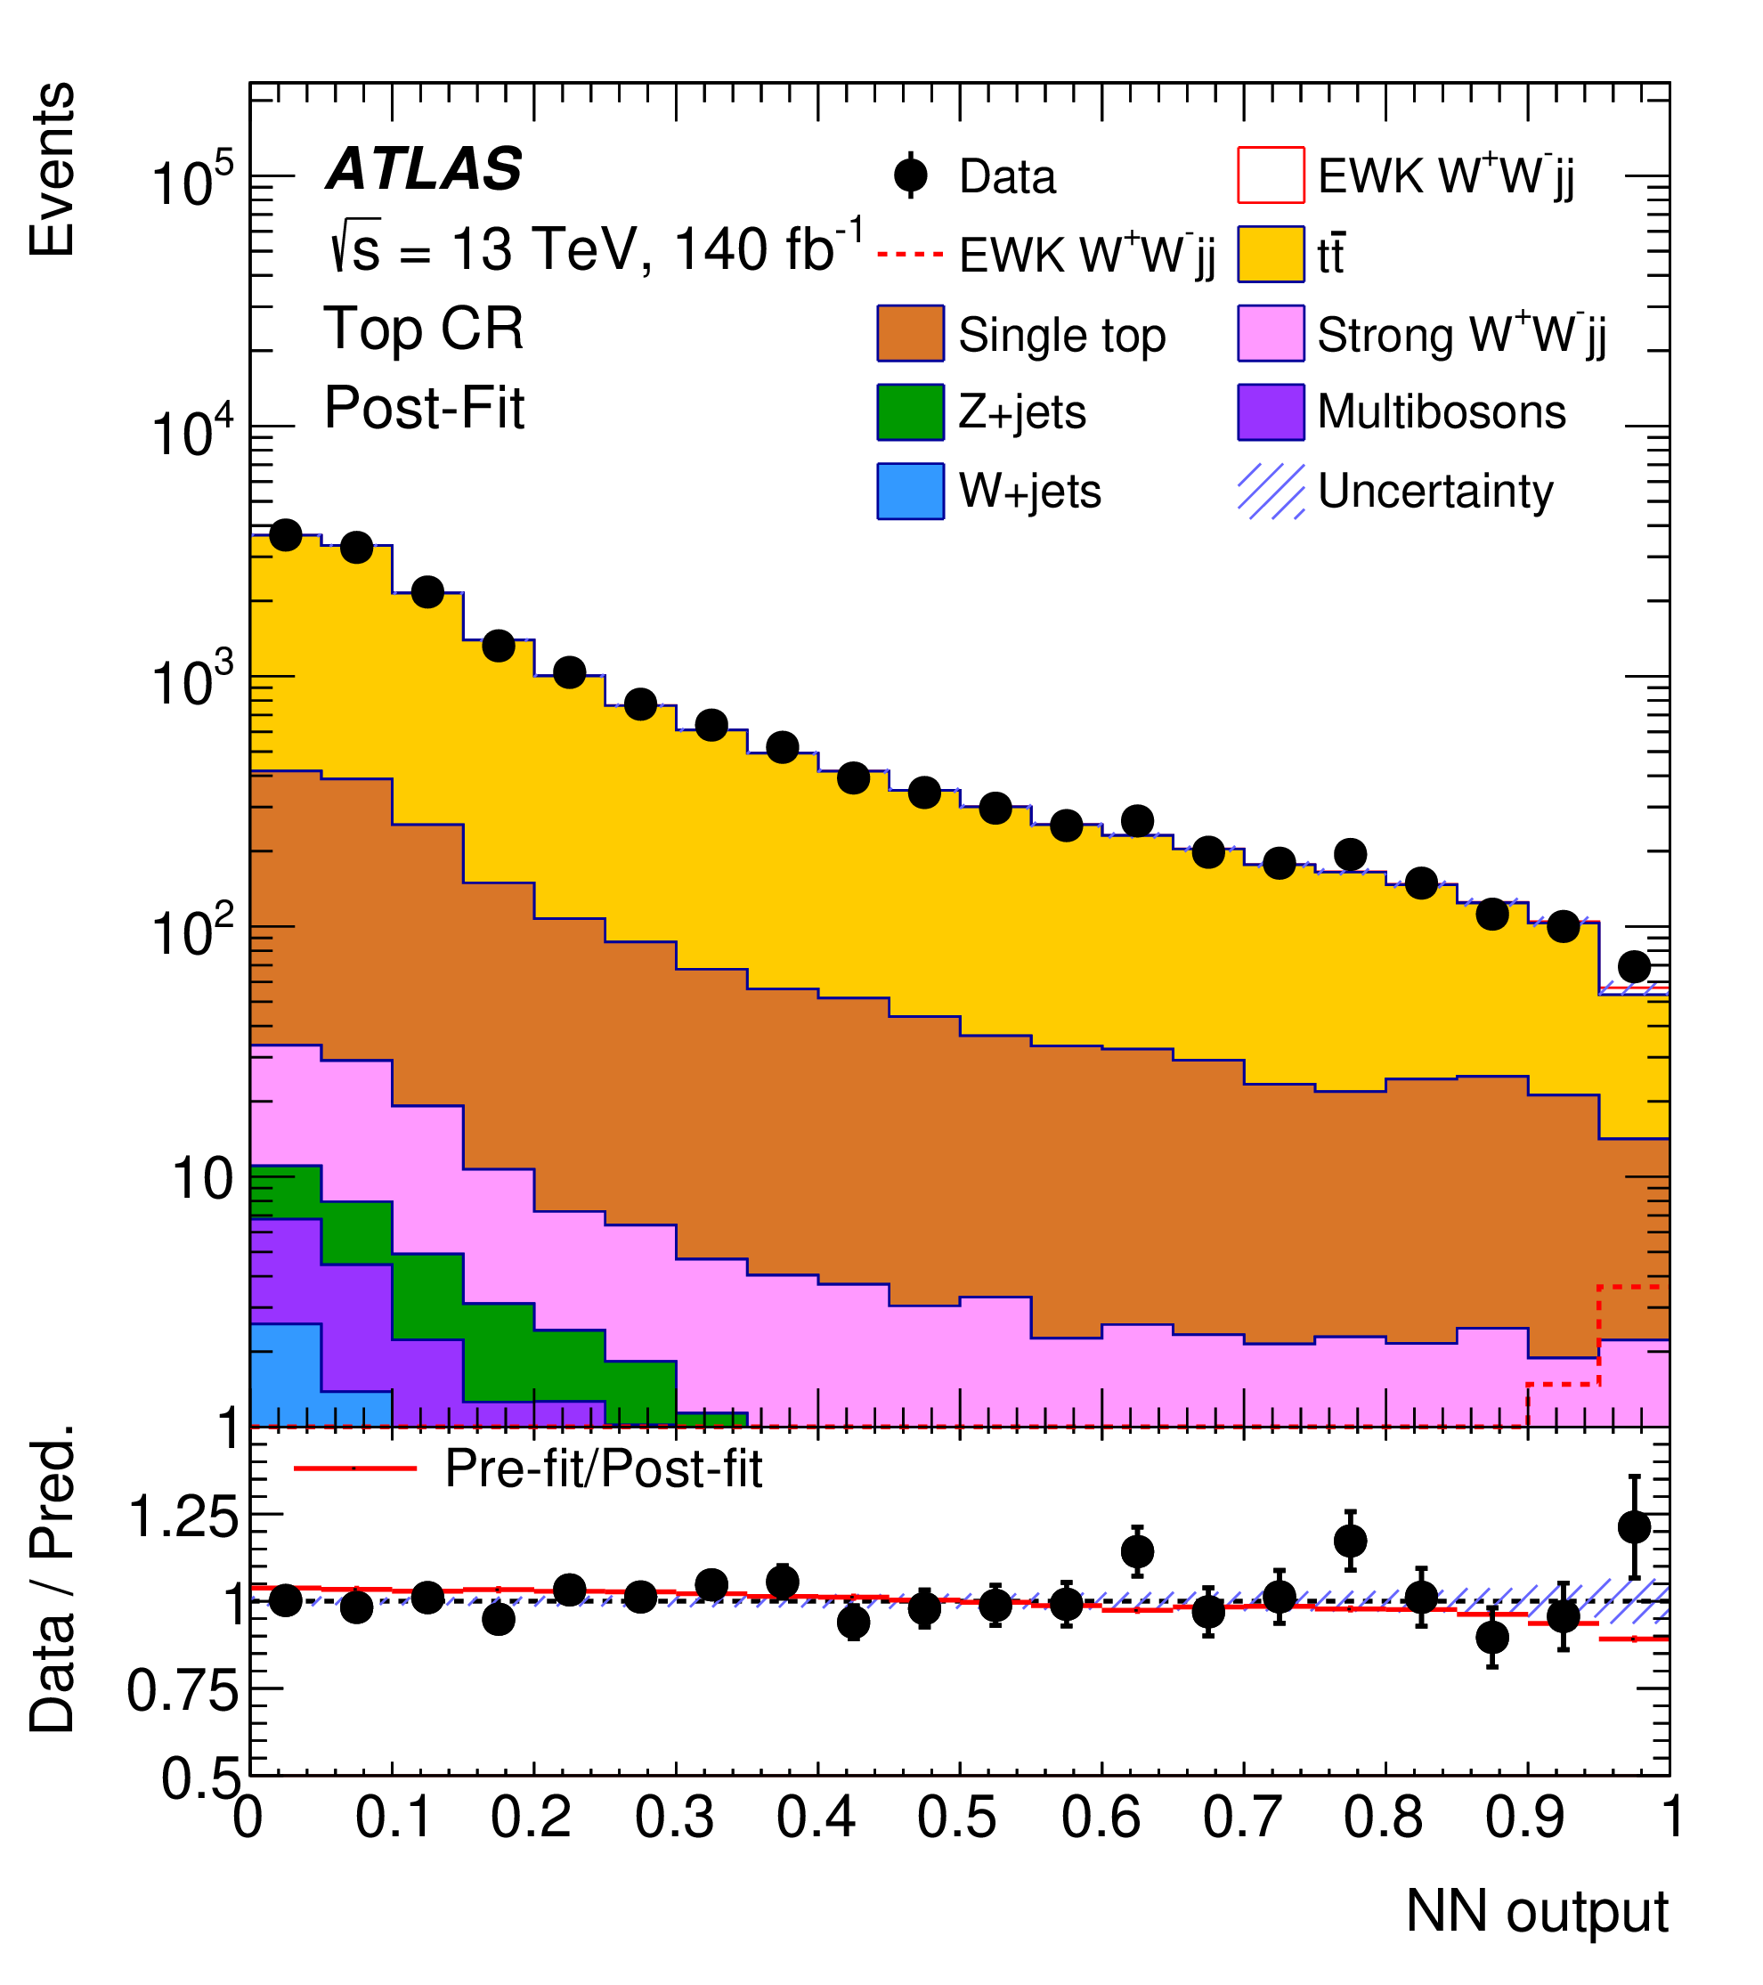
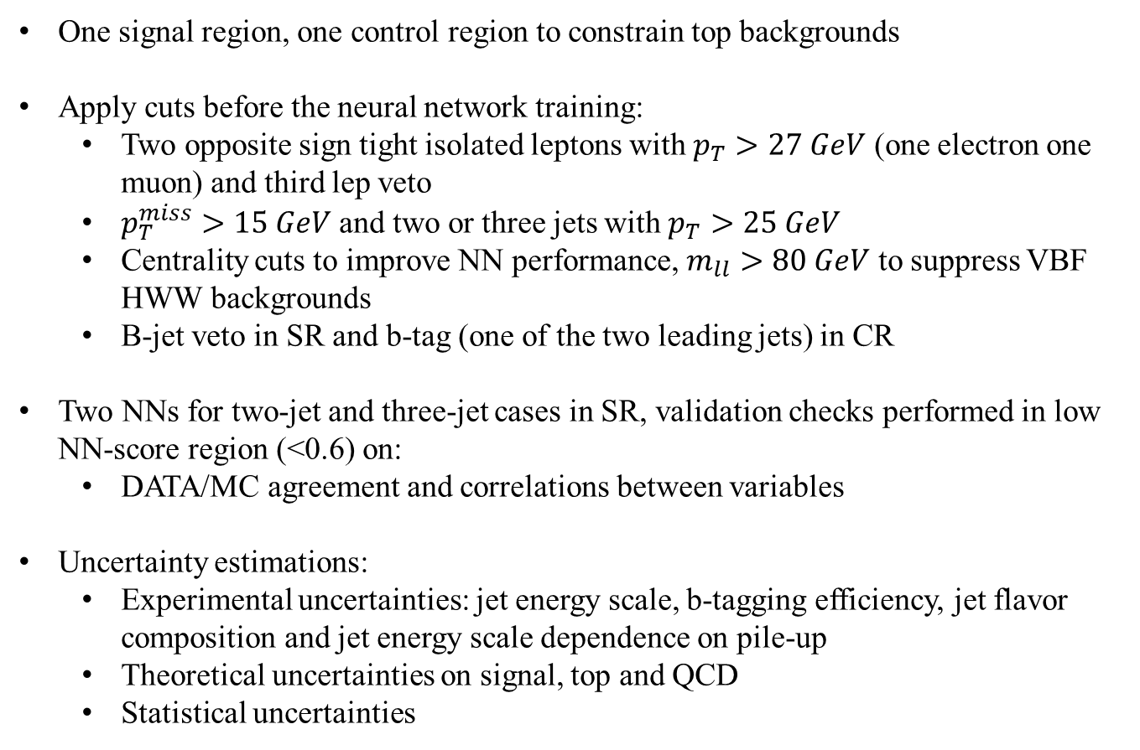

Opposite-sign $W^{+}W^{−}jj$ Strategy
One signal region, one control region to constrain top backgrounds
Apply cuts before the neural network training:
Two opposite sign tight isolated leptons with $p_{T}>27 GeV$ (one electron one muon) and third lep veto
$p_{T}^{miss}>15 GeV$ and two or three jets with $p_{T}>25 GeV$
Centrality cuts to improve NN performance, $m_{ll}>80 GeV$ to suppress VBF HWW backgrounds
B-jet veto in SR and b-tag (one of the two leading jets) in CR
Two NNs for two-jet and three-jet cases in SR, validation checks performed in low NN-score region (<0.6) on:
DATA/MC agreement and correlations between variables
Uncertainty estimations:
Experimental uncertainties: jet energy scale, b-tagging efficiency, jet flavor composition and jet energy scale dependence on pile-up
Theoretical uncertainties on signal, top and QCD
Statistical uncertainties

Slide 10
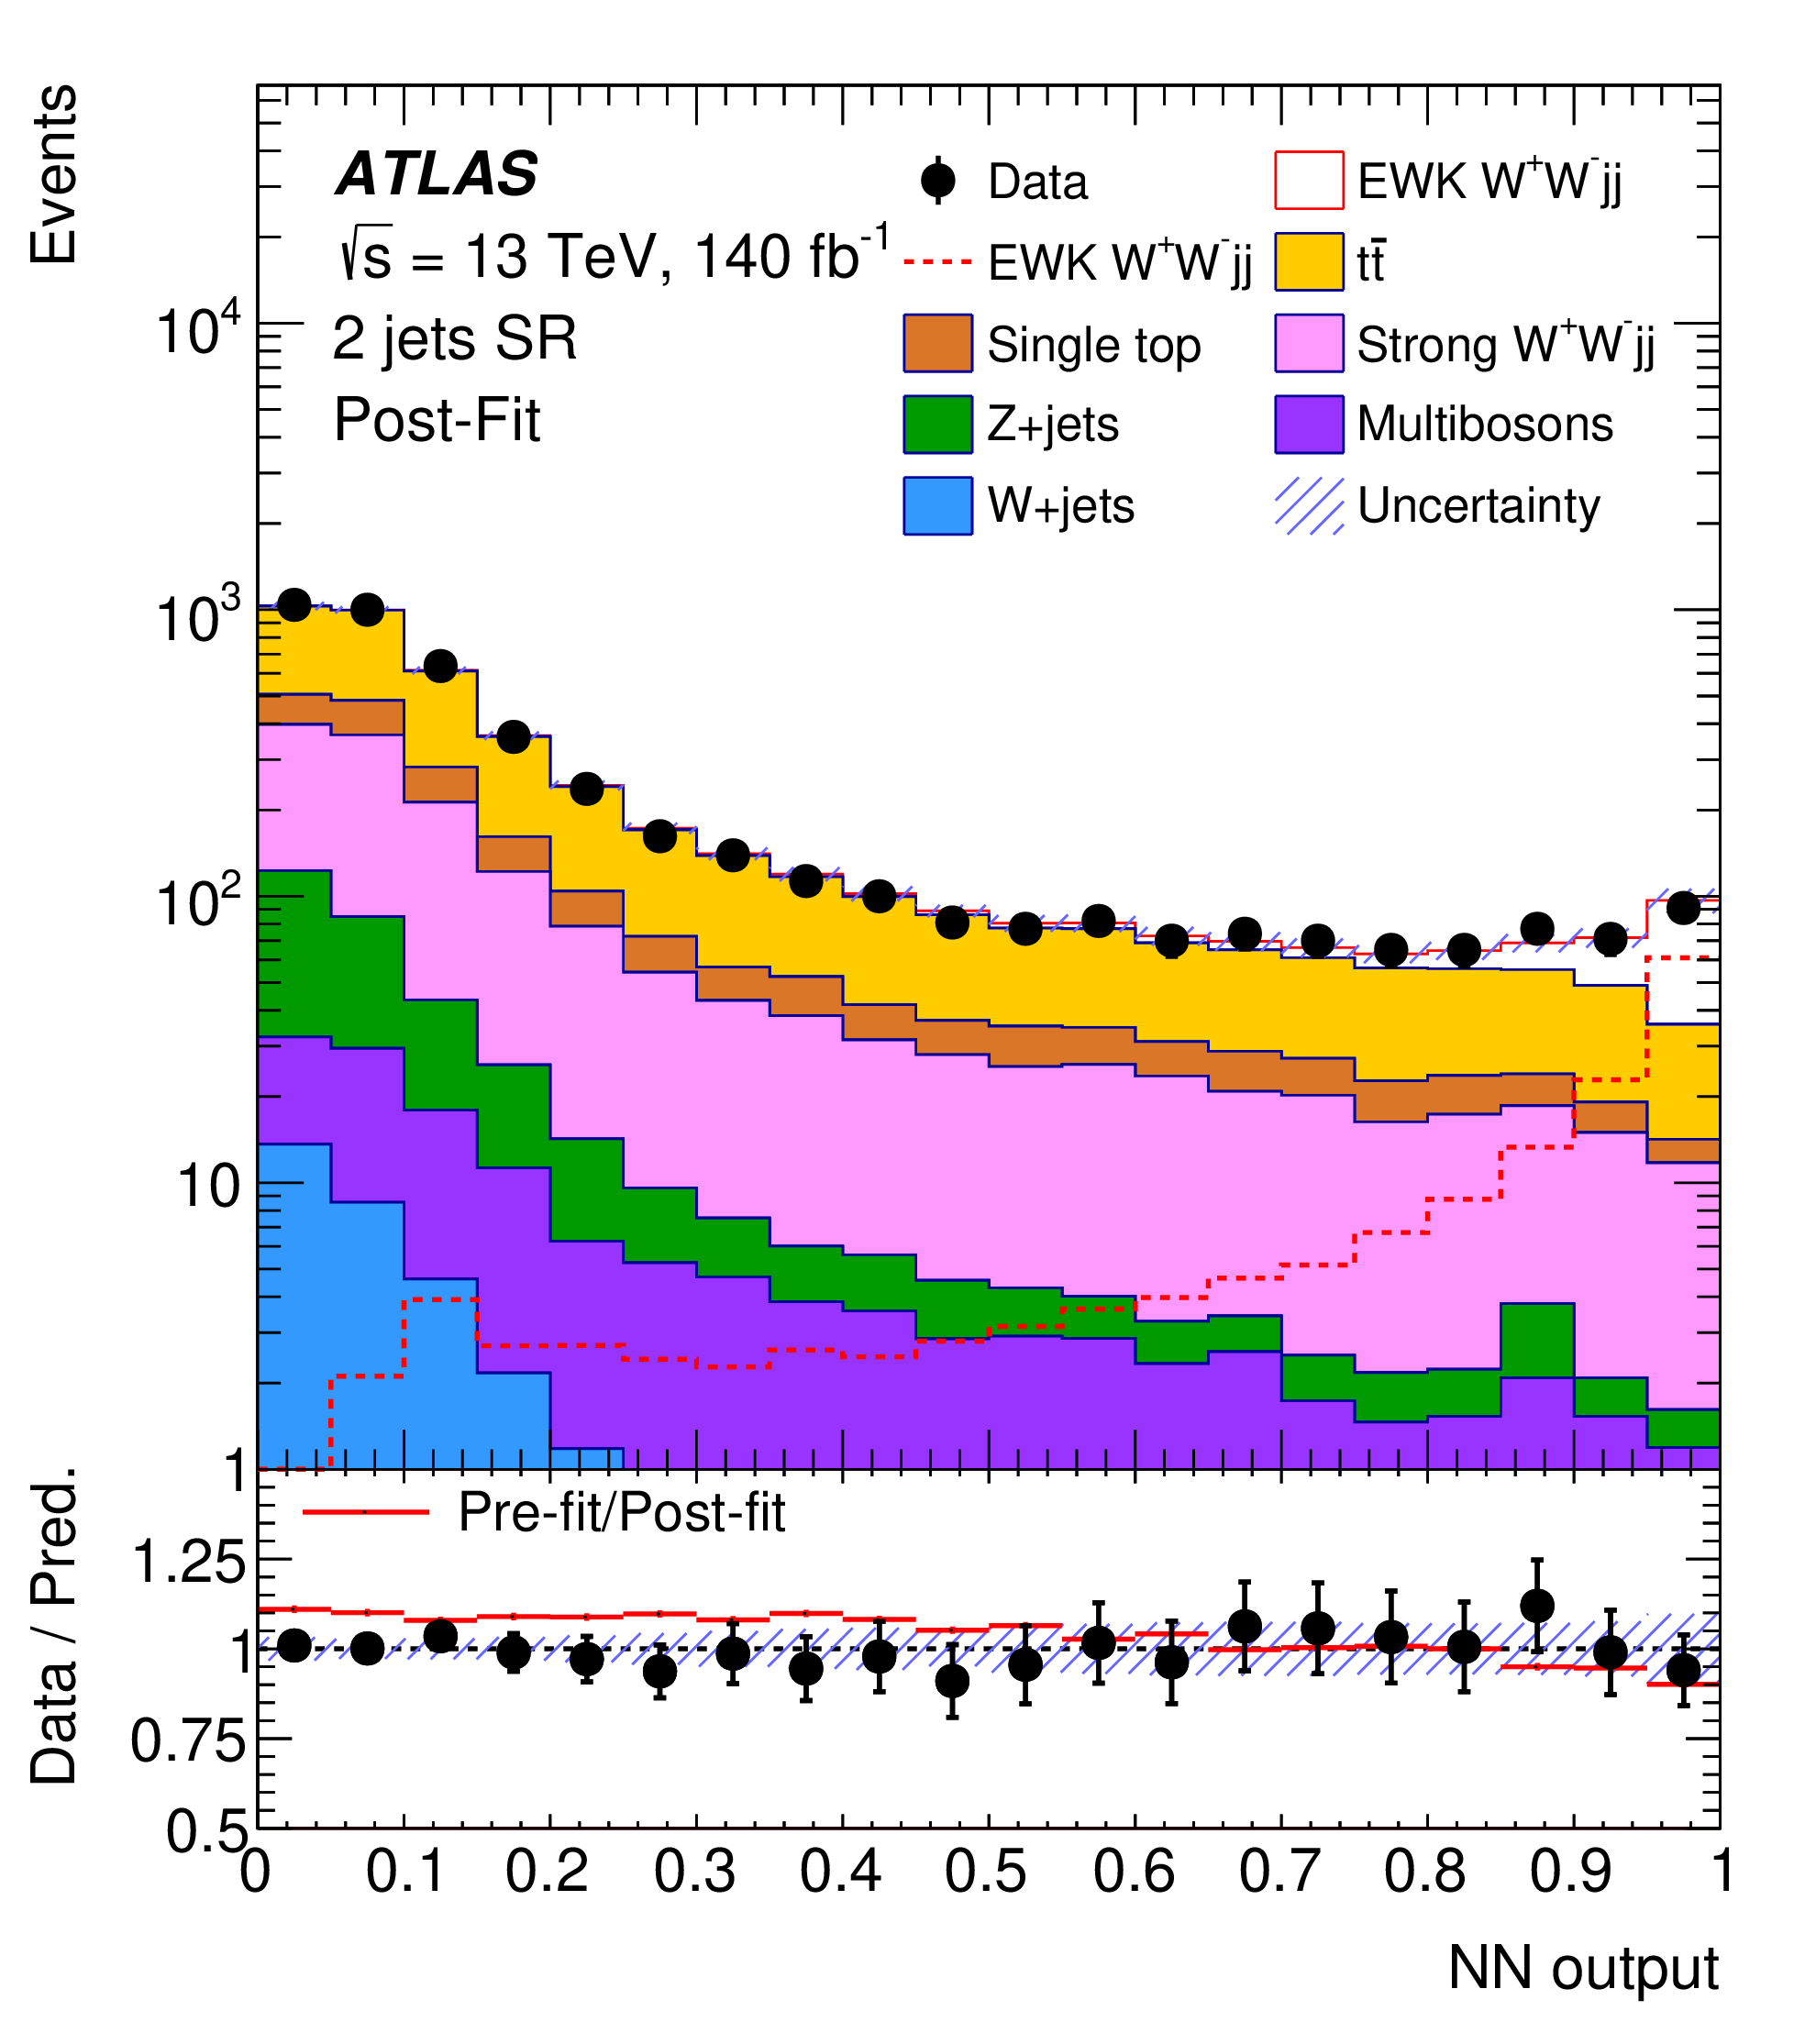
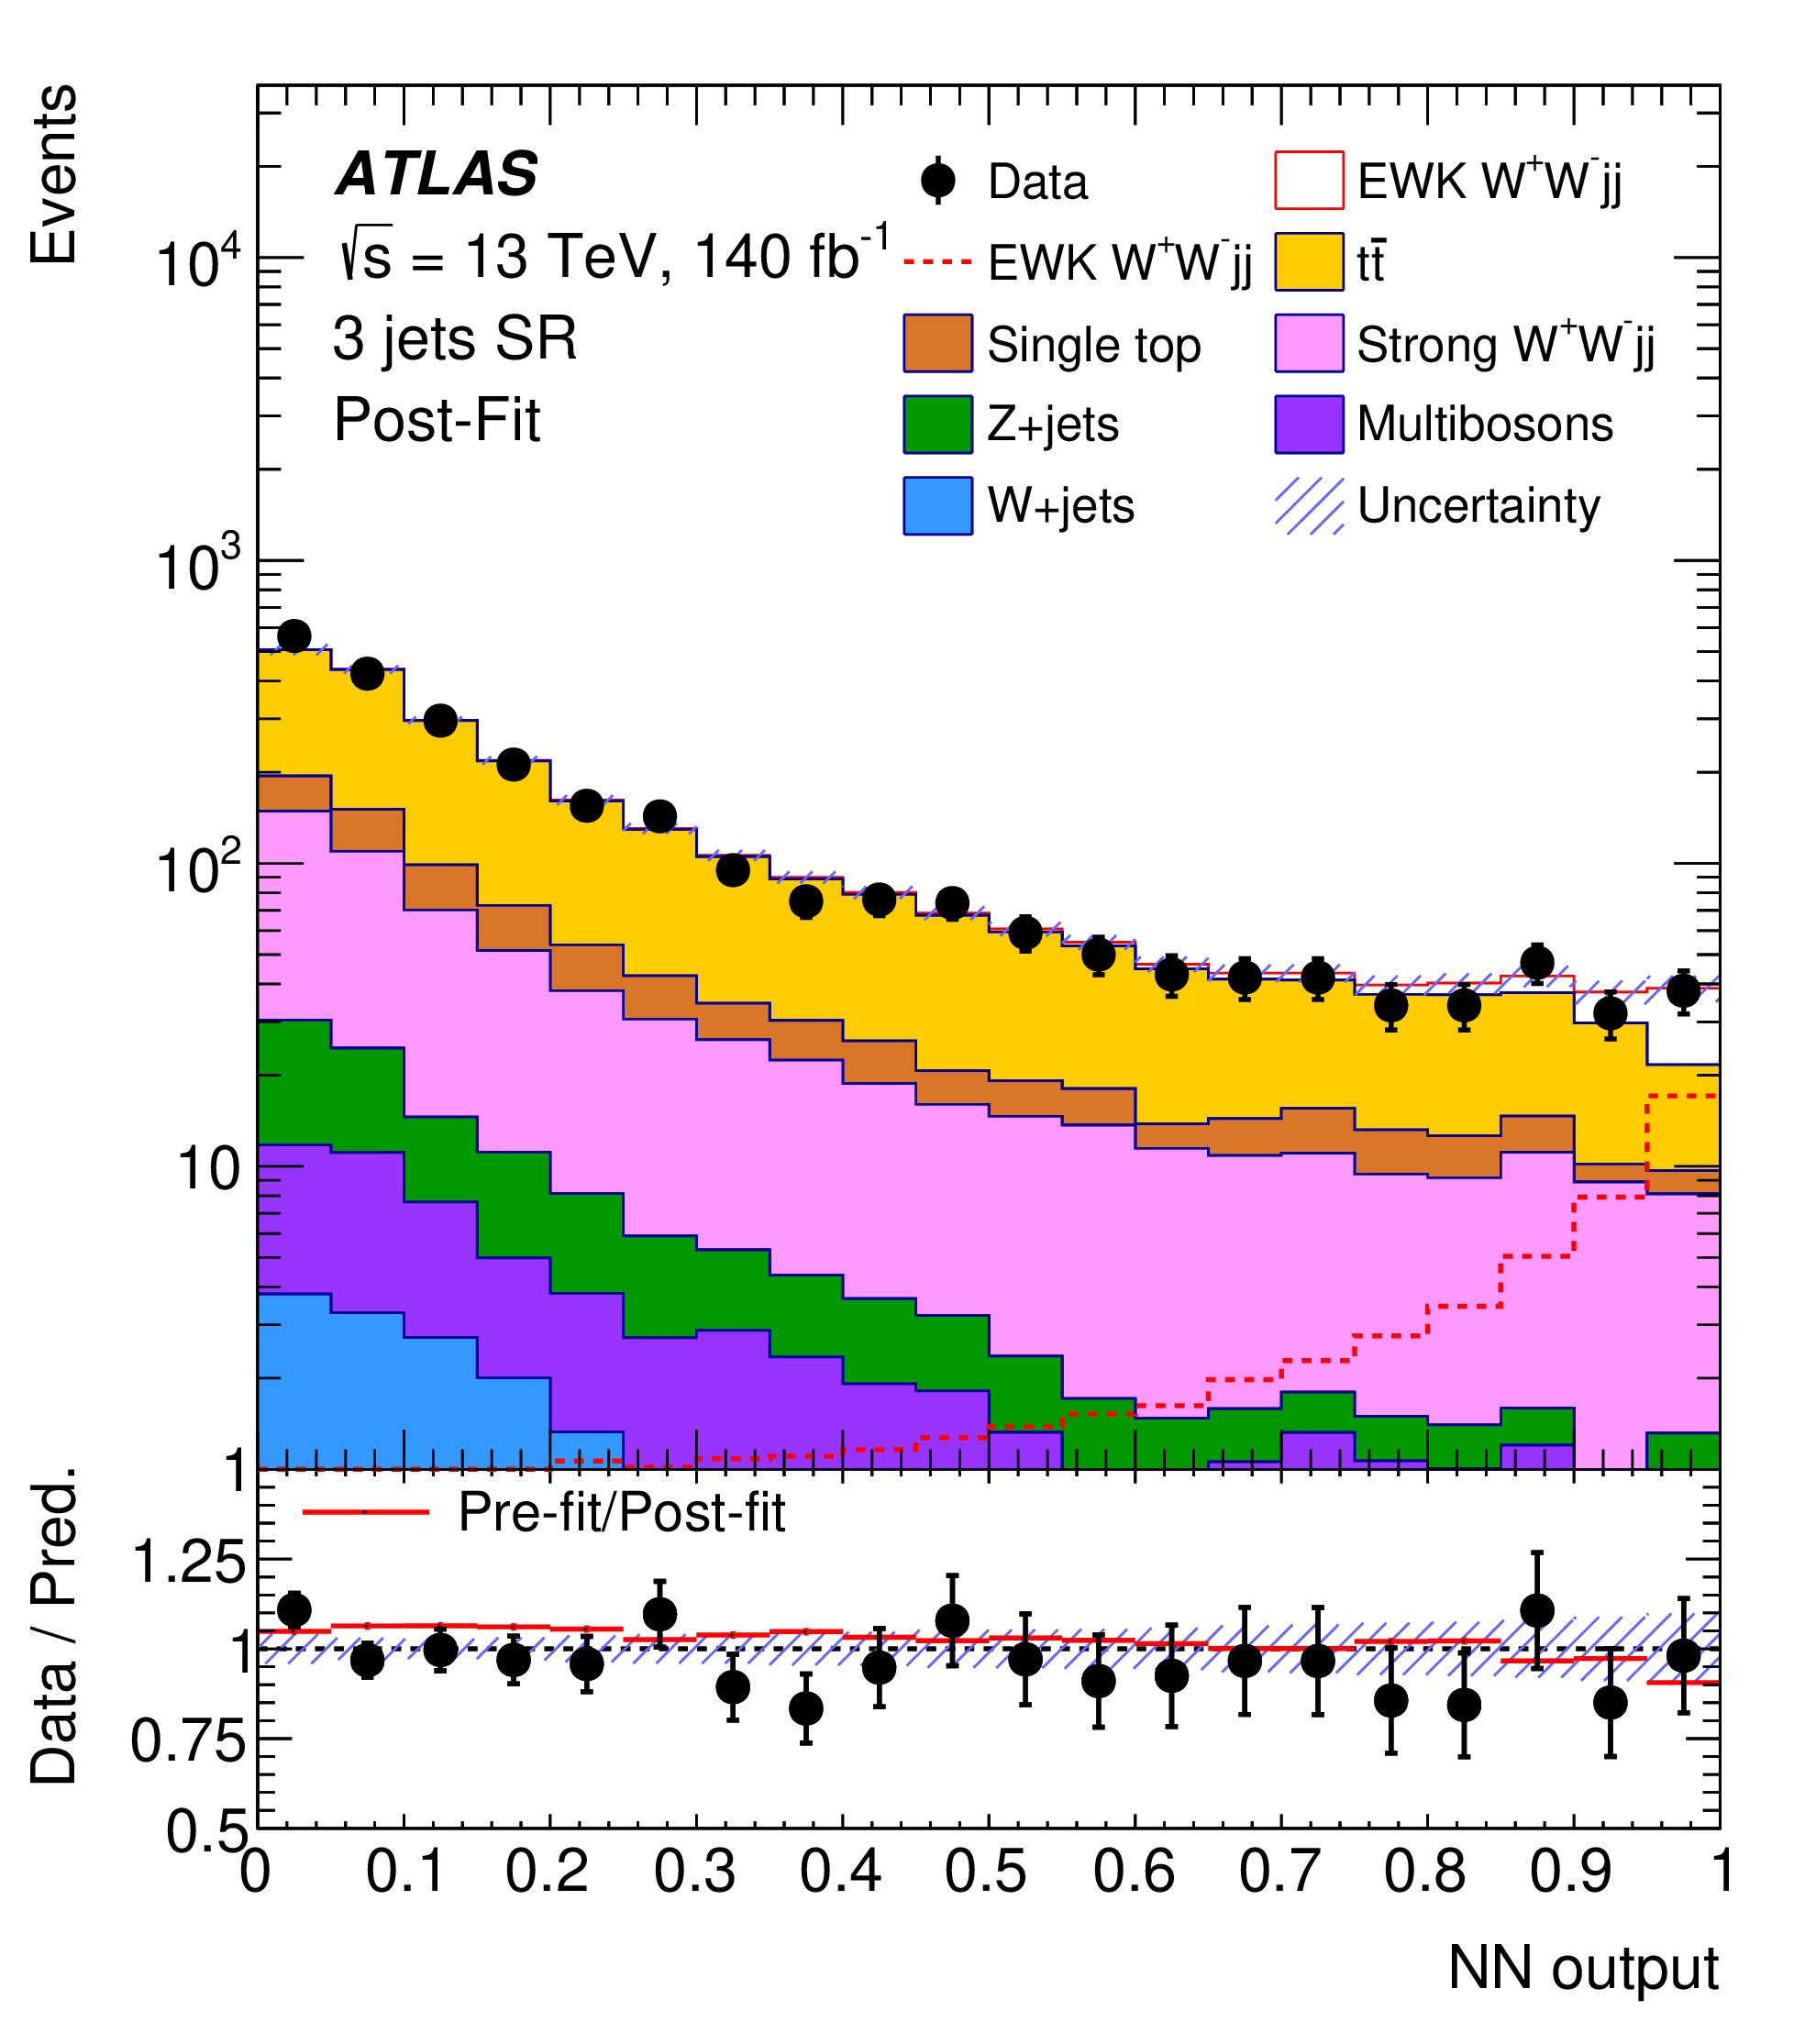
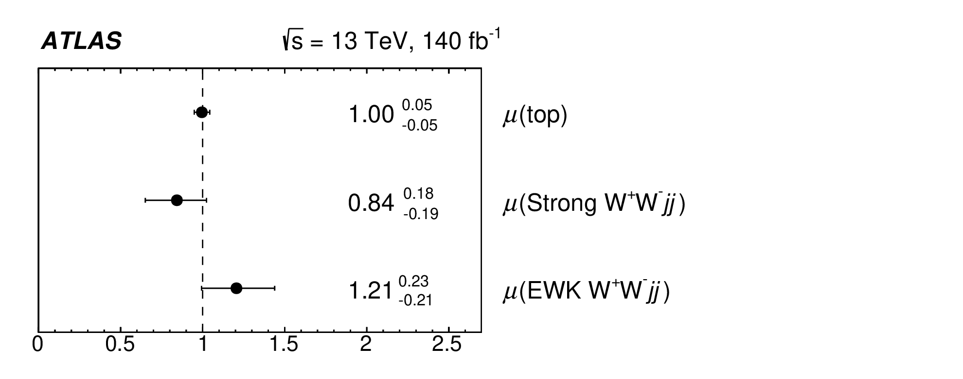
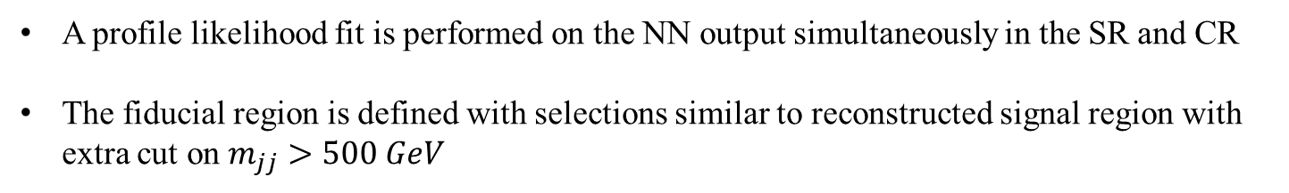
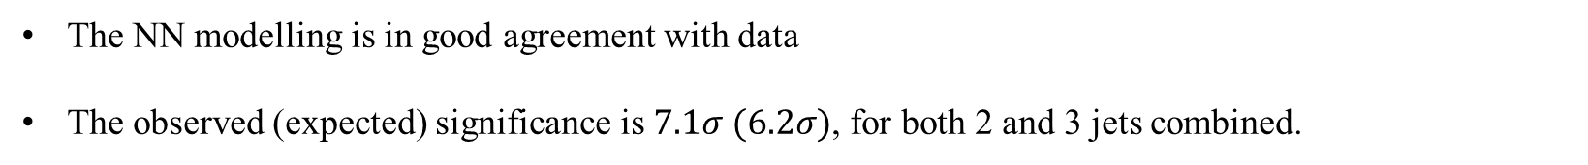
Opposite-sign $W^{+}W^{−}jj$ Fiducial Cross Section
A profile likelihood fit is performed on the NN output simultaneously in the SR and CR
The fiducial region is defined with selections similar to reconstructed signal region with extra cut on $m_{jj}>500 GeV$
The NN modelling is in good agreement with data
The observed (expected) significance is $7.1σ (6.2σ)$, for both 2 and 3 jets combined.

Slide 11
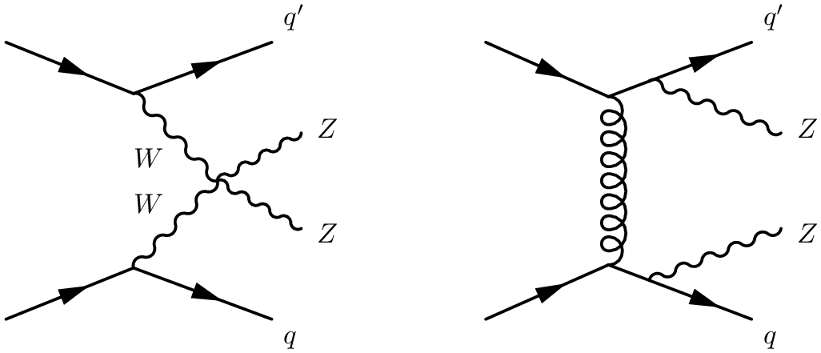
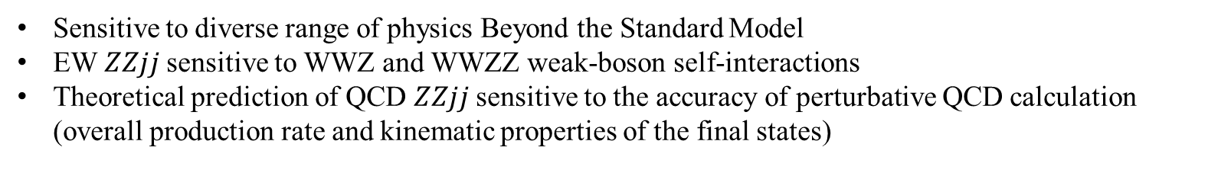

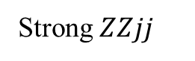
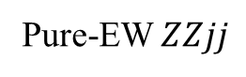
Differential $ZZjj$
Sensitive to diverse range of physics Beyond the Standard Model
EW $ZZjj$ sensitive to WWZ and WWZZ weak-boson self-interactions
Theoretical prediction of QCD $ZZjj$ sensitive to the accuracy of perturbative QCD calculation (overall production rate and kinematic properties of the final states)
Pure-EW $ZZjj$
Strong $ZZjj$
Goals:
Unfolded differential cross section measurement of interesting kinematic observables
Limits on dim-6 and dim-8 EFT operators

Slide 12

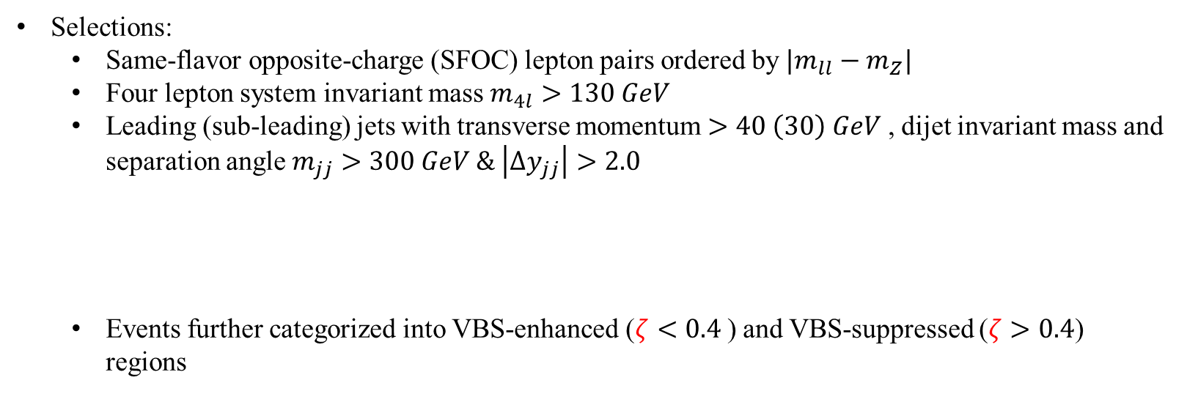
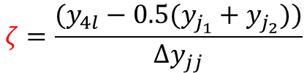
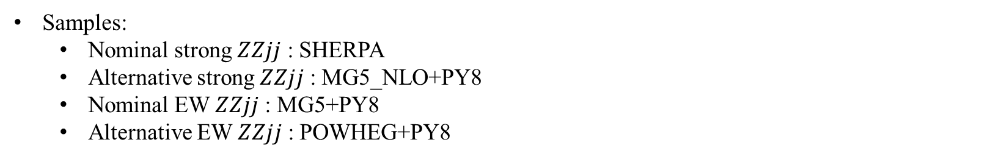
Differential $ZZjj$ Strategy
Selections:
Same-flavor opposite-charge (SFOC) lepton pairs ordered by $|m_{ll}−m_{Z}|$
Four lepton system invariant mass $m_{4l}>130 GeV$
Leading (sub-leading) jets with transverse momentum $>40 \left(30\right) GeV$ , dijet invariant mass and separation angle $m_{jj}>300 GeV \& \left|Δy_{jj}\right|>2.0$
Events further categorized into VBS-enhanced ($ζ<0.4$) and VBS-suppressed ($ζ>0.4$) regions
$$ζ=\frac{(y_{4l}−0.5(y_{j_{1}}+y_{j_{2}}))}{Δy_{jj}}$$
Inclusive measurements on both EW and strong $ZZjj$ production
Samples:
Nominal strong $ZZjj$ : SHERPA
Alternative strong $ZZjj$ : MG5_NLO+PY8
Nominal EW $ZZjj$ : MG5+PY8
Alternative EW $ZZjj$ : POWHEG+PY8

Slide 13
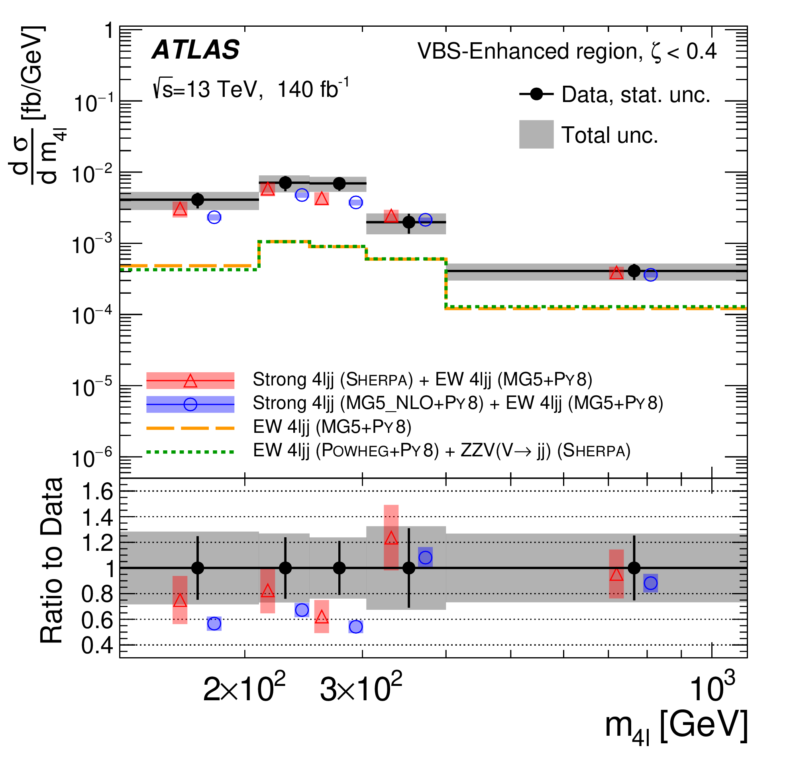
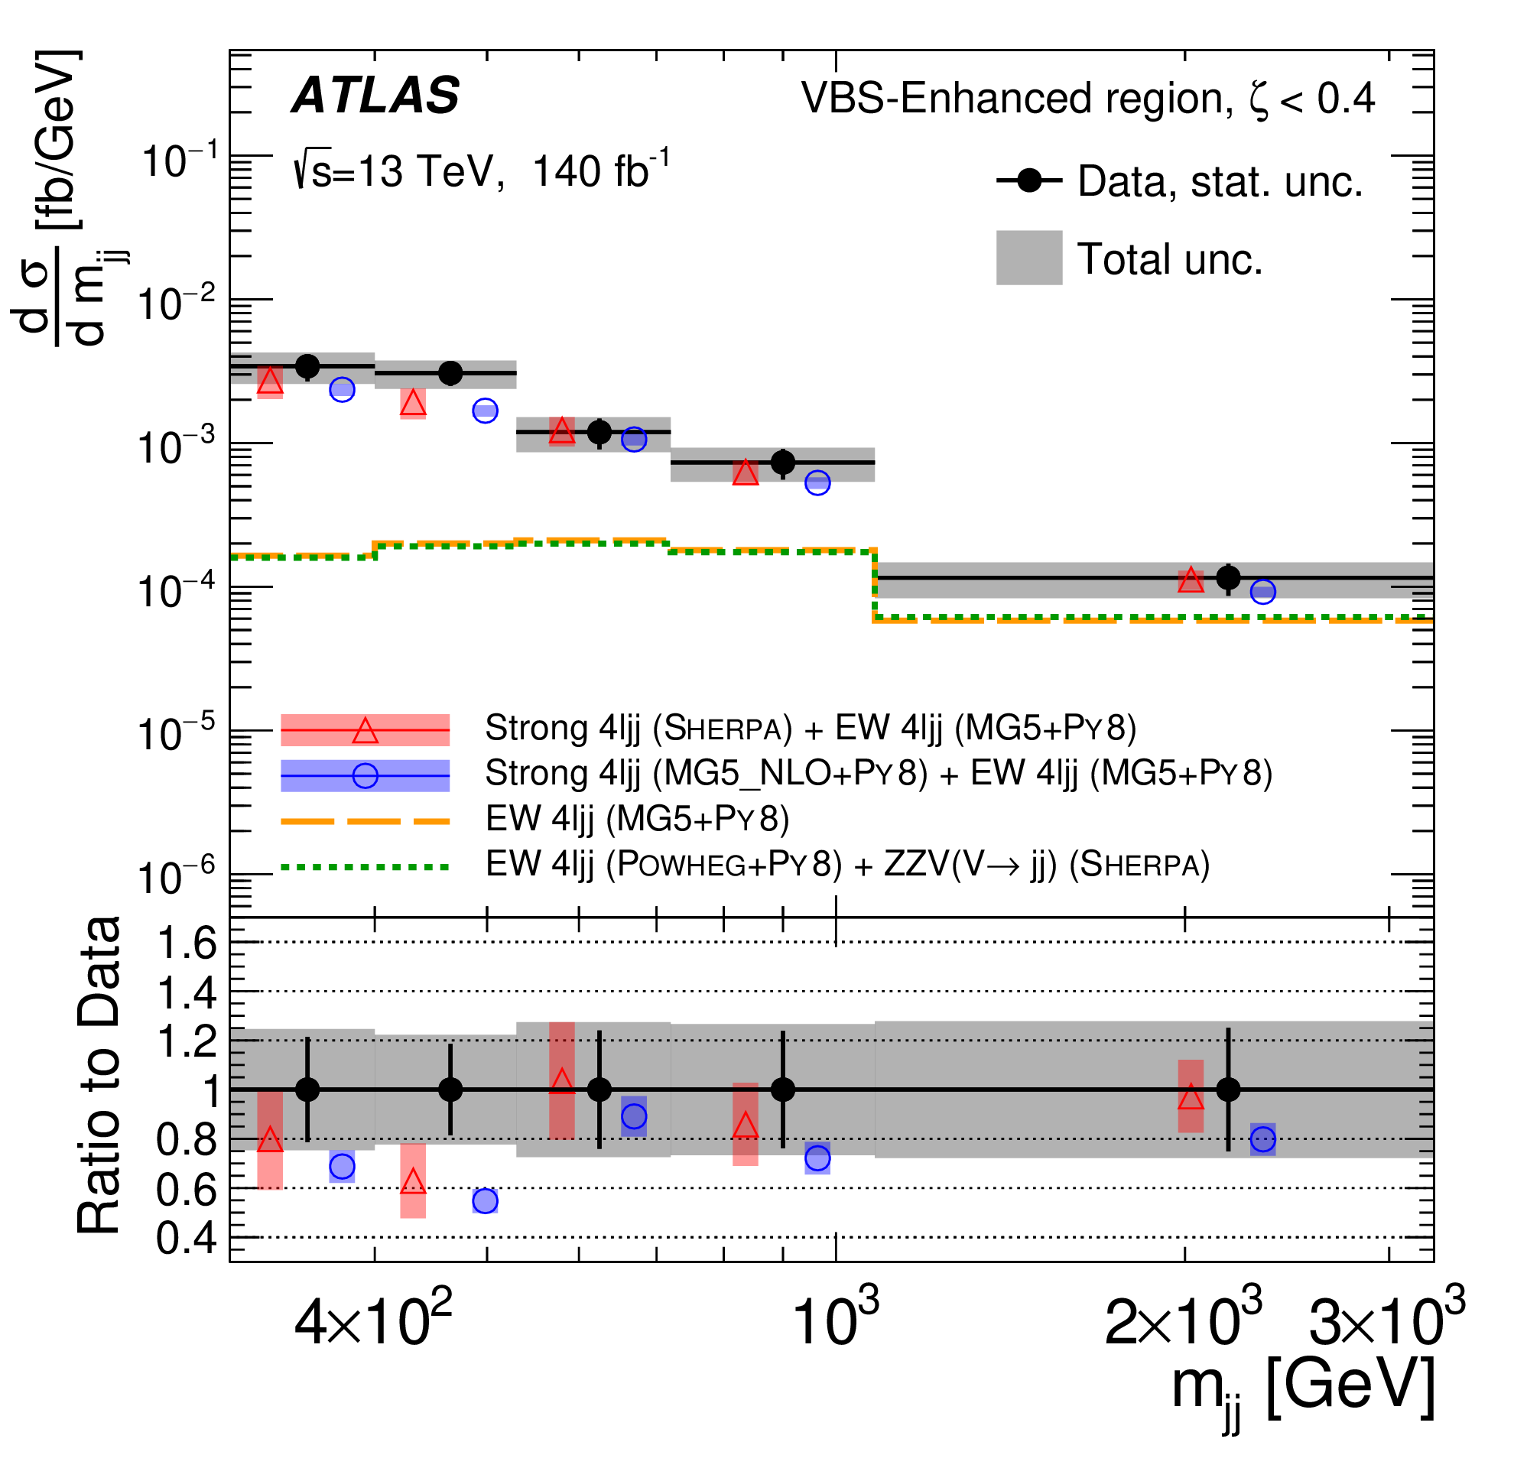
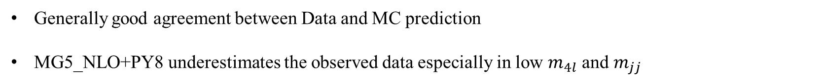
Differential $ZZjj$ Differential Cross Section
Particle-level measurements in both VBS-enhanced and VBS-suppressed fiducial regions
Unfolding done with iterative Bayesian method to correct the detector effect
Generally good agreement between Data and MC prediction
MG5_NLO+PY8 underestimates the observed data especially in low $m_{4l}$ and $m_{jj}$

Slide 14
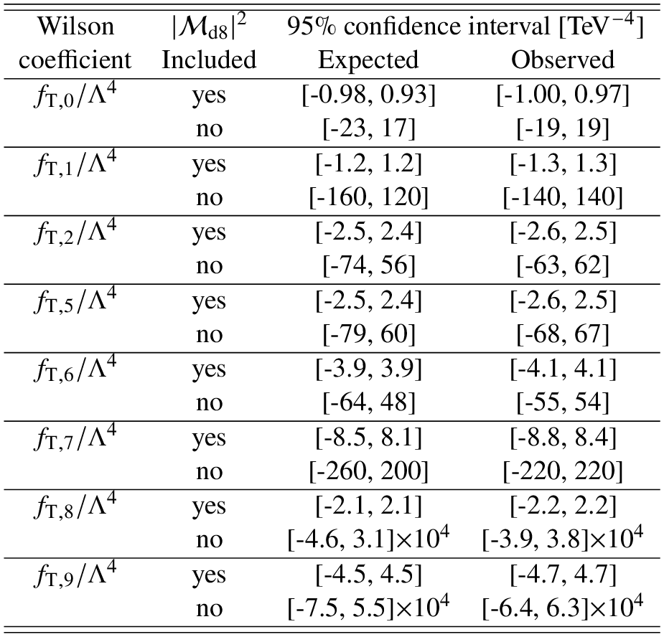
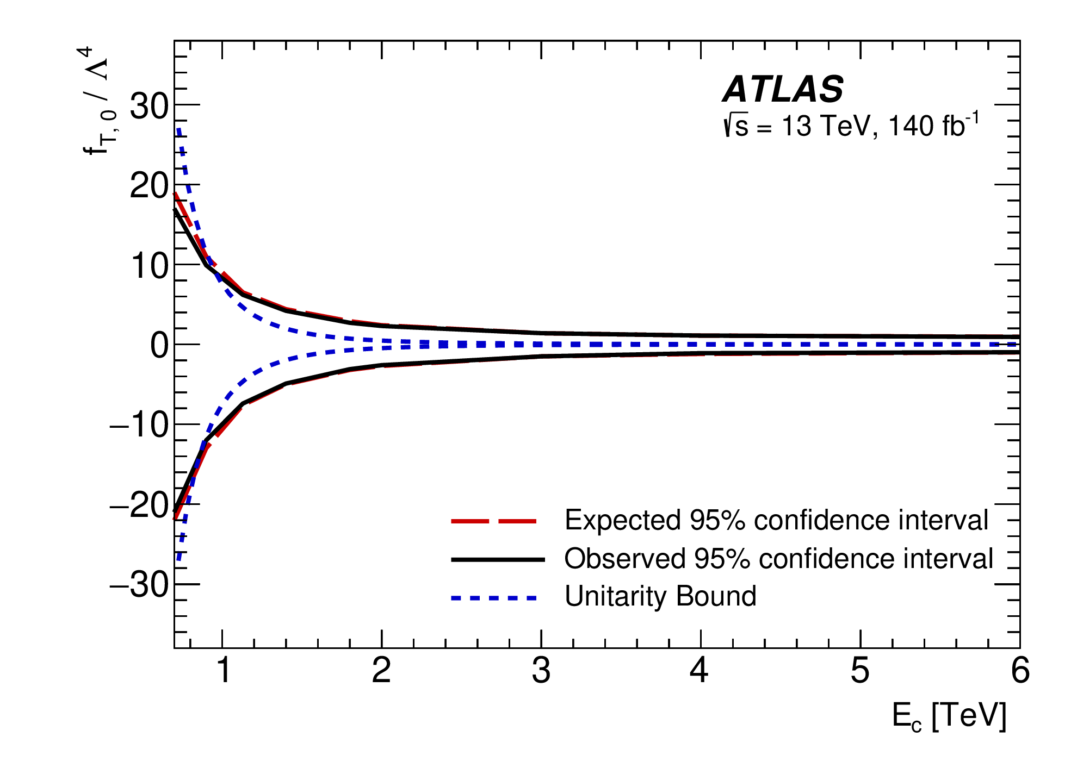
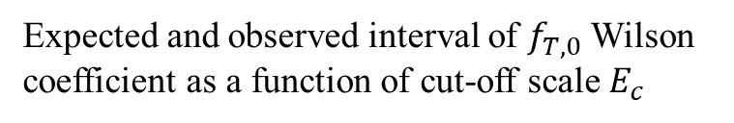
Differential $ZZjj$ EFT Interpretation
Unfolded distribution for the search of physics beyond the SM
$m_{4l}$ and $m_{jj}$ are used to set limits on dim-8 and dim-6 EFT operators
Expected and observed interval of $f_{T,0}$Wilson coefficient as a function of cut-off scale $E_{c}$
Wilson coefficients are consistent with zero when pure D8 contribution is included

Slide 15

VBS $Wγ$ jj

Slide 16

VBS $WZ$ jj

Slide 17
Summary
All non-prompt backgrounds have been investigated with validated data-driven methods
Observed EWK Wyjj production with 8.96(9.16) σ based on Sherpa(Madgraph) templates
Differential cross section measured for 6 variables
Set limits on 16 dimension-8 EFT operators

Slide 19
Backup

Slide 20
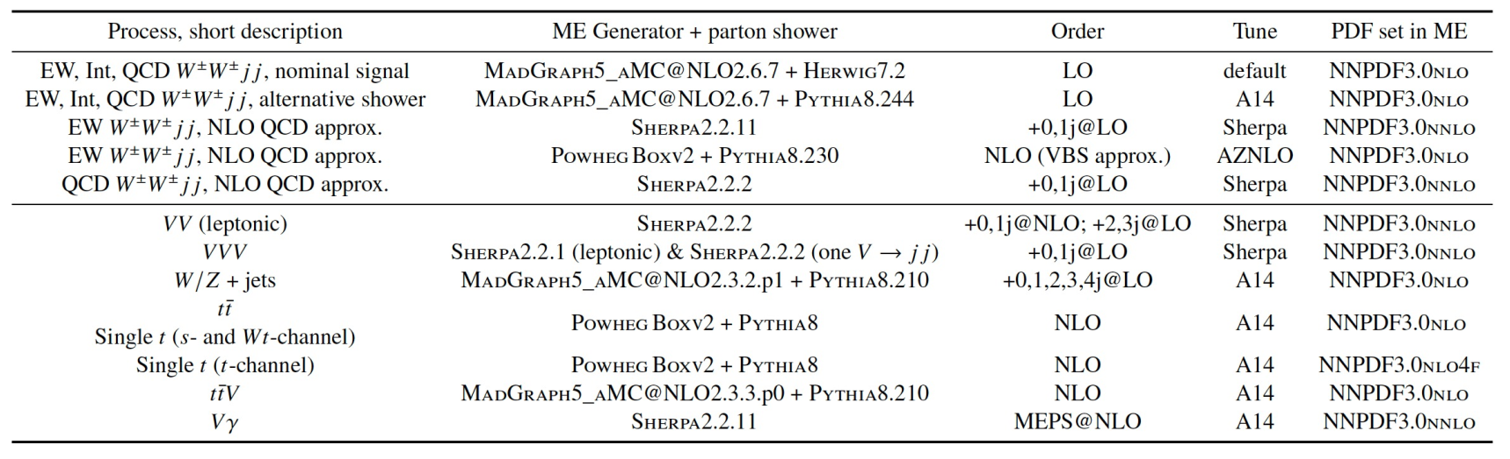

Same-sign $W^{±}W^{±}jj$ Samples

Slide 21
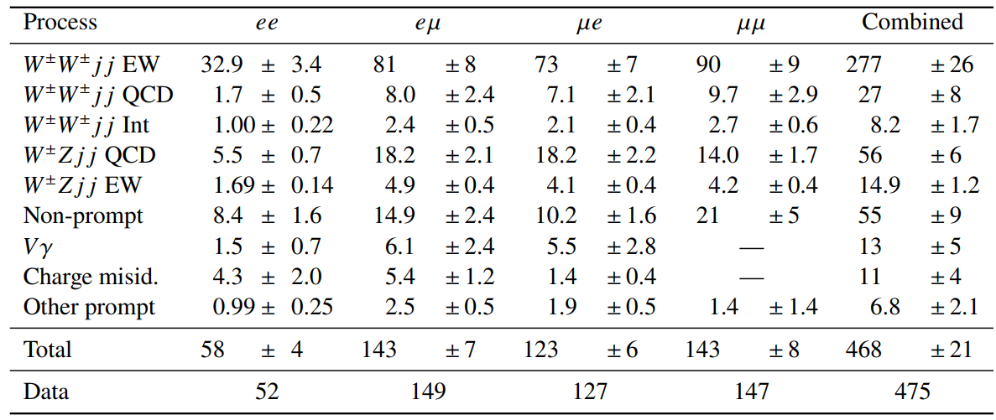

Same-sign $W^{±}W^{±}jj$ Post-fit Yields

Slide 22
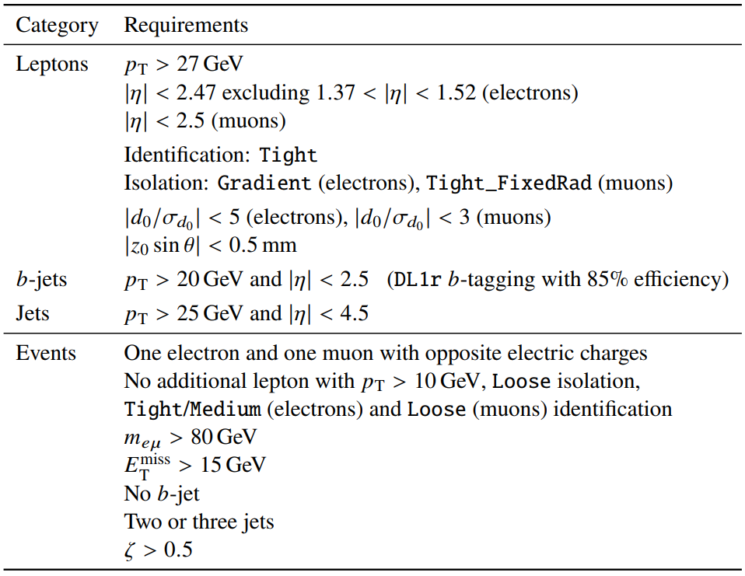

Opposite-sign $W^{+}W^{−}jj$ Selections
Selection cuts on physics objects that define the signal region

